Slide 1
INTRODUCTION TO EMBEDDED SYSTEM
Er. Sahit Baral may 5/2022

Slide 2
Reference Books:
David E. Simon, “An Embedded Software Primer”, Addison-Wesley, 2005
Muhammad Ali Mazidi, “8051 Microcontroller and Embedded
Systems”, Prentice Hall, 2006
Frank Vahid, Tony Givargis, “Embedded System Design”, John Wiley & Sons, 2008
Douglas L. Perry, “VHDL Programming by example”, McGraw Hill, 2002
Shibu K V, “Introduction to EMBEDDED SYSTEMS”, McGrawHill, 2009

Slide 3
1. Introduction to Embedded System [3 Hrs.]
1.1 General Characteristics of Embedded Systems
1.2 Classification of Embedded Systems
1.3 Essential Components
1.4 Overview of Processors and Hardware units in an embedded systems
1.5 Application of embedded System

Slide 4
System Definition
A way of working, organizing or performing one or many tasks according to a fixed set of rules, program or plan.
Also an arrangement in which all units assemble and work together according to a program or plan.
Examples of Systems
Time display system – A watch
Automatic cloth washing system - A washing machine

Slide 5
Embedded System Overview
An Embedded System
Is an electronic/electromechanical system designed to perform a specific function and is a combination of both hardware and firmware (software).
Is a system built to perform its duty, completely or partially independent of human intervention.
Is specially designed to perform a few tasks in the most efficient way.
Interacts with physical elements in our environment, controlling and driving a motor, sensing temperature, …
The programs written for the embedded system can also be referred as firmware which is stored in read-only memory

Slide 6
Embedded System Definition
Example : Digital watch
A digital watch with the simple configuration can obtained 8-bit processor, register, counters, real time clocks as electronic component
And other hardware elements of the watch can be buttons/touch screen for the input and screen & speaker for output
Modern car contains embedded systems like embedded airbag system, navigation system, adaptive cruise control and others

Slide 7
Embedded System
A system which is a combination of special purpose hardware and embedded OS for executing a specific set of application
May or may not contain an operating system for functioning
The firmware of the embedded system is pre- programmed and it is non- alterable by the end-user (there may be exceptions for system supporting OS kernel image flashing through special hardware settings)
Application-specific requirement (like performance, power requirements, memory usage, etc.) are the key deciding factors
Highly tailored to take advantage of the power saving modes supported by the hardware and the operating system

Slide 8
Embedded System
For certain category of ESs like mission critical systems, the response time requirement is highly critical
Execution behavior is deterministic for certain types of ESs like ‘Hard Real Time’ systems

Slide 9
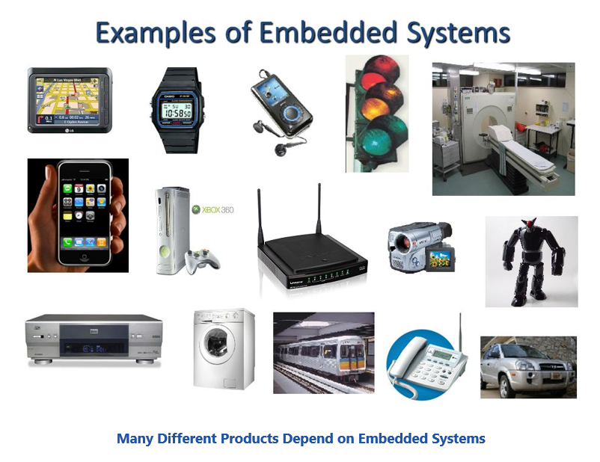

Slide 10
Characteristic’s Of ES
Single functioned
Executes a single program, repeatedly
Tightly constraints
Low cost, low power, small, fast, etc
Reactive and real time
Continually reacts to changes in the system’s environment
Must compute certain results in real-time without delay

Slide 11
Characteristic’s Of ES
Microprocessors based
It must be microprocessor or microcontroller based.
Memory
It must have a memory, as its software usually embeds in ROM. It does not need any secondary memories in the computer.
Connected
It must have connected peripherals to connect input and output devices.
HW-SW systems
Software is used for more features and flexibility. Hardware is used for performance and security.

Slide 12
ES components
ES has mainly three components
Hardware
Application software
Real – time operating system (RTOS) [small scale ES may not require RTOS]

Slide 13
ES components
1. Hardware
It is represents the physical component of the system which interact with each other to perform the specific task.
Examples: Processor, RAM, ROM, ADC, DAC, Timers, Ports etc.

Slide 14
ES components
2. Application software
The application software may perform concurrently the series of tasks or multiple tasks.
Generally they are written in Assembly, C, C++, Java etc.

Slide 15
ES components
3. Real – time operating system (RTOS)
It supervises the applications software and provide a mechanism to let the processor run a process scheduling and do the context-switch between various tasks
RTOS defines the way the systems works and sets the rules during the execution of the applications software
Examples: Win CE, VxWorks, Embedded Linux etc.

Slide 16
Design Metrics
NRE cost (Non-reoccurring engineering costs)
It represent the monitory cost for designing the system. Since the cost doesn’t occur more than once for a particular system
Unit cost
It is the monitory cost of manufacturing each unit of the system excluding NRE cost
Size
It is a physical space required by the system,
For software (bytes)/ For hardware(no. of gates or transistor)
Performance
It is measured in terms of execution time of the system

Slide 17
Design Metrics
Flexibility
The ability to change the functionality of the systems without incurring the heavy NRE cost
Time to Prototype
The time to build the working version of system, which may be bigger or costlier than the final system implementation
Time to market
The time required to develop a system, which may be bigger or costlier than the final system implementation
Maintainability
The ability to modify the system after it initial release

Slide 18
Design Metrics
Power
The amount of power consumed by the system, which may determine the lifetime of battery, or the cooling requirement of the ICs
Correctness
Check the functionality throughout the process of designing the systems
Insert the check circuitry to check that manufacturing was correct
Safety
The system is supposed to be no harm

Slide 19
Classification of Embedded systems
Based on different criteria:
1. Based on generation
2. Complexity and performance requirements
3. Based on deterministic behavior
4. Based on triggering

Slide 20
Classification based on Generation
First Generation:
ES were built around 8 bit microprocessors like 8085, and Z80, and 4 bit microcontrollers.
Simple in hardware circuits with firmware developed in Assembly code. e.g. telephone keypads, stepper motor control unit.

Slide 21
Classification based on Generation
Second Generation:
ES are built around 16 bit microprocessors and 8/16 bit microcontrollers.
The instruction set for the second generation processors/controllers were much more complex and powerful then 1st generation.
Some of 2nd G ESs contained embedded operating systems for their operation.
Example: Data Acquisition System, SCADA (Supervisory Control And Data Acquisition) system.

Slide 22
Classification based on Generation
Third Generation:
With advances in processor tech., ES developers started making use of powerful 32 bit processor 16 bit microcontrollers for their design
Along with complex and powerful instruction sets, instruction pipelining was introduced for better performance
Dedicated embedded real time operating system
Application specific processor like Digital Signal Processor(DSP) and Application Specific Integrated Circuit(ASIC) came into existence

Slide 23
Classification based on Generation
Fourth Generation:
The advent of System on Chip (SoC), reconfigurable processors and multicore processors are bringing high performance, tight integration and miniaturization into the embedded device market.
The SoC technique implements a total system on a chip by integrating different functionalities with a processor core on an IC.
Smart phone devices, mobile internet device.

Slide 24
Classification based on Complexity & Performance:
Small-Scale ESs:
These systems are designed with single 8 or 16 bit microprocessors or microcontrollers
ESs which are simple in application needs where the performance requirements are not time critical fall under this category.
Less hardware/firmware complexities and may be battery operated
Editor/Assembler/Cross-assemblers is used as a main programming tool and C language is used for developing these systems
Eg. Automatic vending machine, stepper motor controller for robotics system

Slide 25
Classification based on Complexity & Performance:
Medium-Scale ESs:
ESs are slightly complex in hardware and firmware requirements fall under this category
Systems are design with Single of few 16-bit or 32-bit microcontroller or DSPs or RISCs
Easily available single purpose processor for various functions, for example bus interfacing, encryption, deciphering and so on.
For software design, the programming tools used in RTOS, source code engineering tools, simulator, debugger and integrated development environment(IDE)
Eg. Computer networking systems, signal tracking system

Slide 26
Classification based on Complexity & Performance:
Large-Scale ESs/Complex Systems:
ESs which are highly complex hardware and firmware requirements fall under this category.
They are employed in mission critical applications demanding high performance. Such systems are commonly built around high performance 32 or 64 bit RISC processor/controllers or Reconfigurable System on Chip (RSoC) or multi-core processor and programmable logic devices.
e.g. multiple processor/controllers and co-units/hardware accelerators for offloading the processing requirements from the main processor of the system, Decoding/encoding of media, cryptographic function implementation.
RTOS for task scheduling, prioritization and management.
For eg. Wireless LANs, convergent technology devices
Notes:
Converging technology means combining multiple technologies into one. Simple example- a phone with alarm, calculator, came ra, music, video, intern et, etc

Slide 27
On deterministic behavior:-
This classification is applicable for “Real Time” systems.
The task execution behavior for an embedded system may be deterministic or non-deterministic.
Based on execution behavior Real Time embedded systems are divided into Hard and Soft.

Slide 28
On triggering:-
Embedded systems which are “Reactive” in nature can be based on triggering.
Reactive systems can be:
• Event triggered
• Time triggered

Slide 29
Purpose of Embedded Systems
Data Collection/ Storage/ Representation
Data Communication
Data (signal) processing(DSP)
Monitoring
Control
Application specific user interface

Slide 30
Applications:
1. Consumer electronics: camcorders, cameras
2. Household Appliances: TV, DVD players, washing machine
3. Home automation and security systems: Aircon, CCTV, fire alarms
4. Automatic industry: engine control, ignition system, navigation
5. Telecom: Cell Phone, tel. switches, hand set multimedia appl.
6. Computer peripherals: Printer, scanners, fax machines
7. Computer Networking System: Network routers, switches, hubs
8. Healthcare: diff. kind of scanners, EEG, ECG machine
9. Measurement & Instrumentation: digital multi-meter, CROs
10. Banking & Retail: ATM, currency counter, point of sales (POS)
11. Card Reader: Barcode, smart card reader, hand held devices

Slide 31
Assignment.1
Explain Single purpose processors, General purpose processors, Application specific processor with its block diagram

